Slide 1

AIRLINE
DATASET
Centrality Measures

Slide 2



03 | Dataset
04 | Flight Route Plot
05 | Distribution of Centralities
06 | Heatmap
07 | Airport Hubs
08 | Quick route Airports
09 | Most Efficient Hubs
10 | Shortest Path (Dijkstra’s)
Agenda

Slide 3
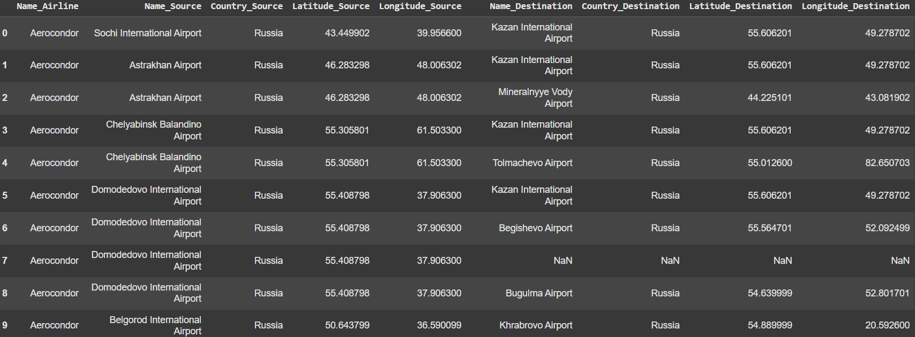
DATASET

Slide 4
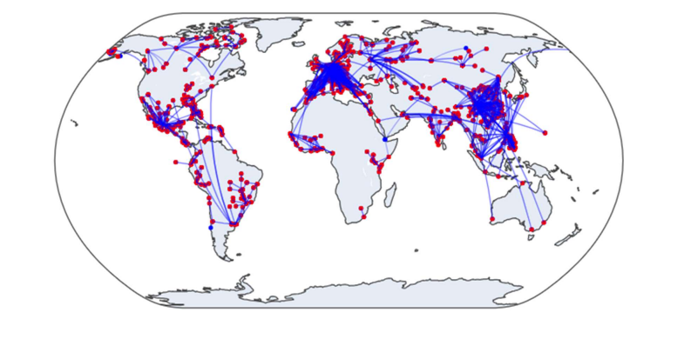
FLIGHT-ROUTE PLOT

Slide 5
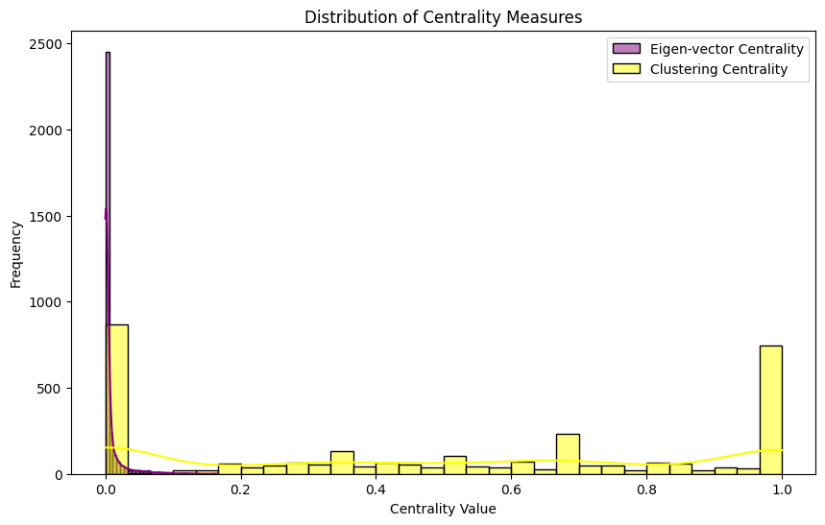
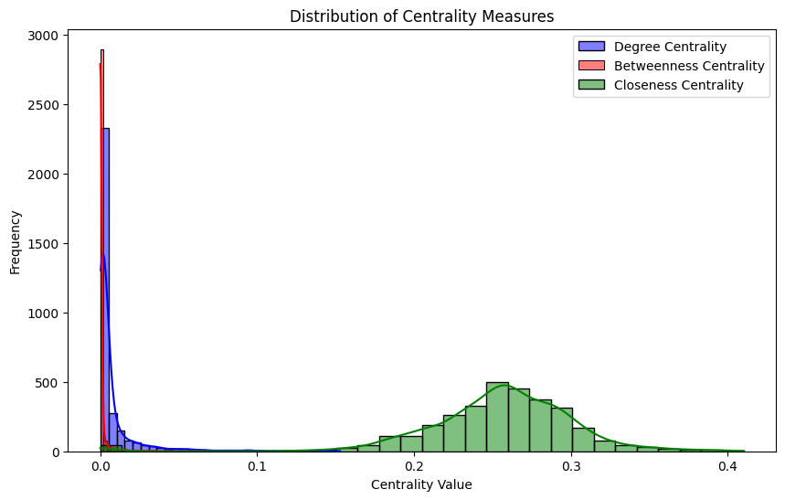
DISTRIBUTION OF CENTRALITIES

Slide 6
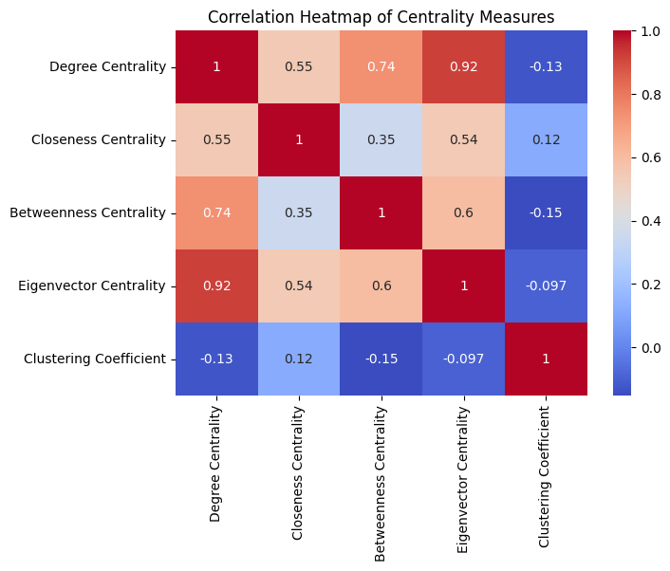
Heatmap
Degree-Betweeness
-High correlation: direct connection - critical intermediates
Degree-Eigen vector
-High correlation: direct connection to influential airports
Betweeness - Closeness
-Low correlation: intermediates doesn’t always have shortest path

Slide 7

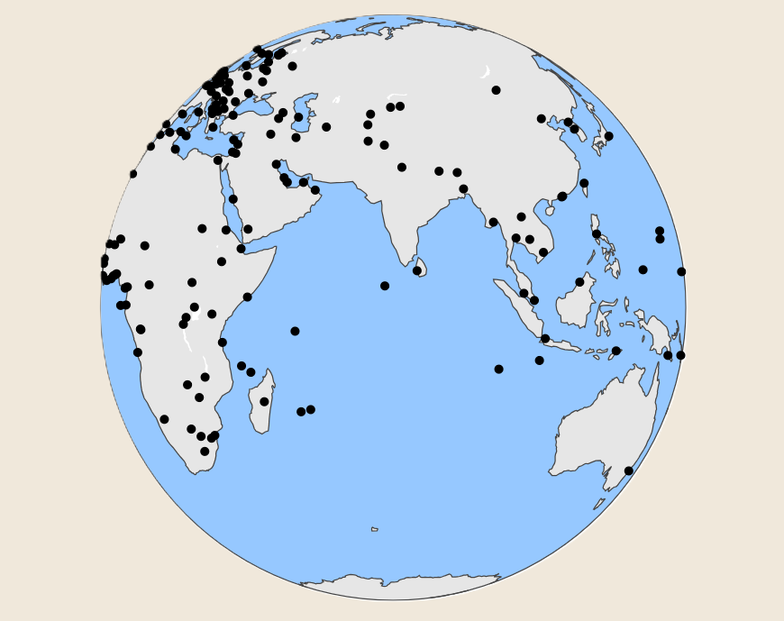
AIRPORT- HUBS
Computed Degree Centrality for all airports to measure their connectivity.
Identified Highly Connected Airports in each country based on their Degree Centrality scores.
Mapped These Airports as HUBs, selecting those with the highest connectivity per country.

Slide 8
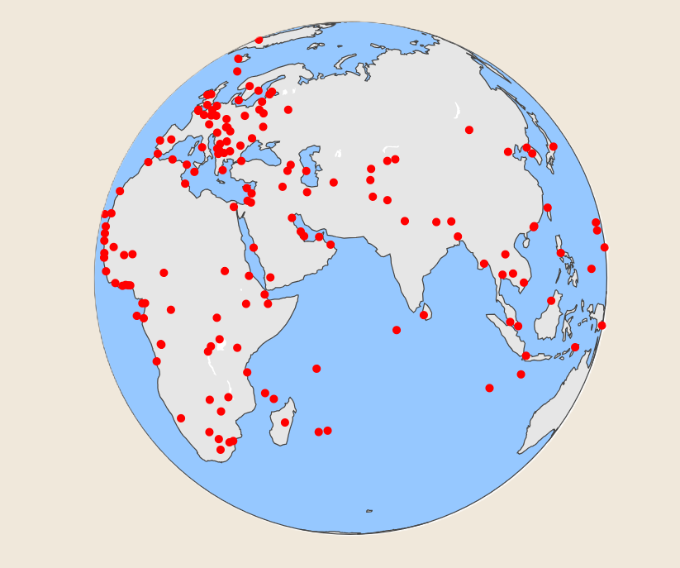
QUICK ROUTE AIRPORTS
Computed Closeness Centrality to assess how quickly each airport connects to others.
Identified Airports with High Closeness Scores in each country for optimal accessibility.
Mapped These Airports as Key Hubs, ensuring minimal travel distance across the network.

Slide 9
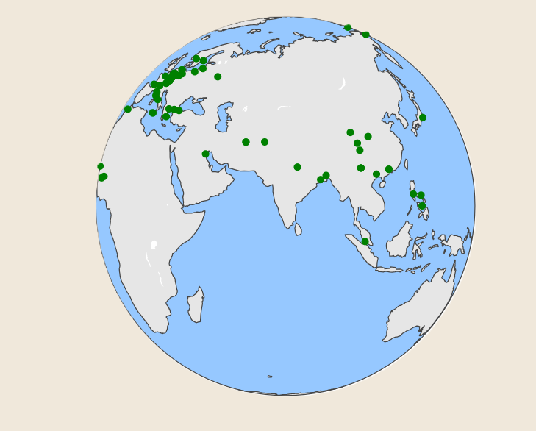
MOST EFFICIENT HUBS
Compared Degree and Closeness Centrality to assess both connectivity and efficiency
.
Identified Airports with Low Closeness Centrality, indicating potential bottlenecks.
Removed Bottlenecks to refine the selection of the most efficient hubs for seamless connectivity.

Slide 10
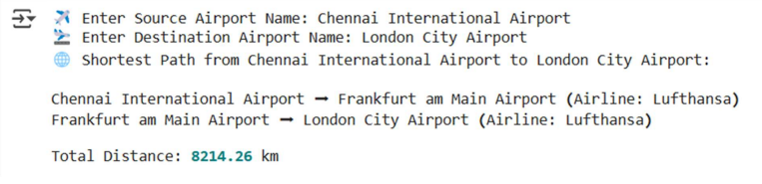
DIJKSTRA’S ALGORITHM - SHORTEST PATH

